Slide 1





ESSAY
WRITING

Slide 2
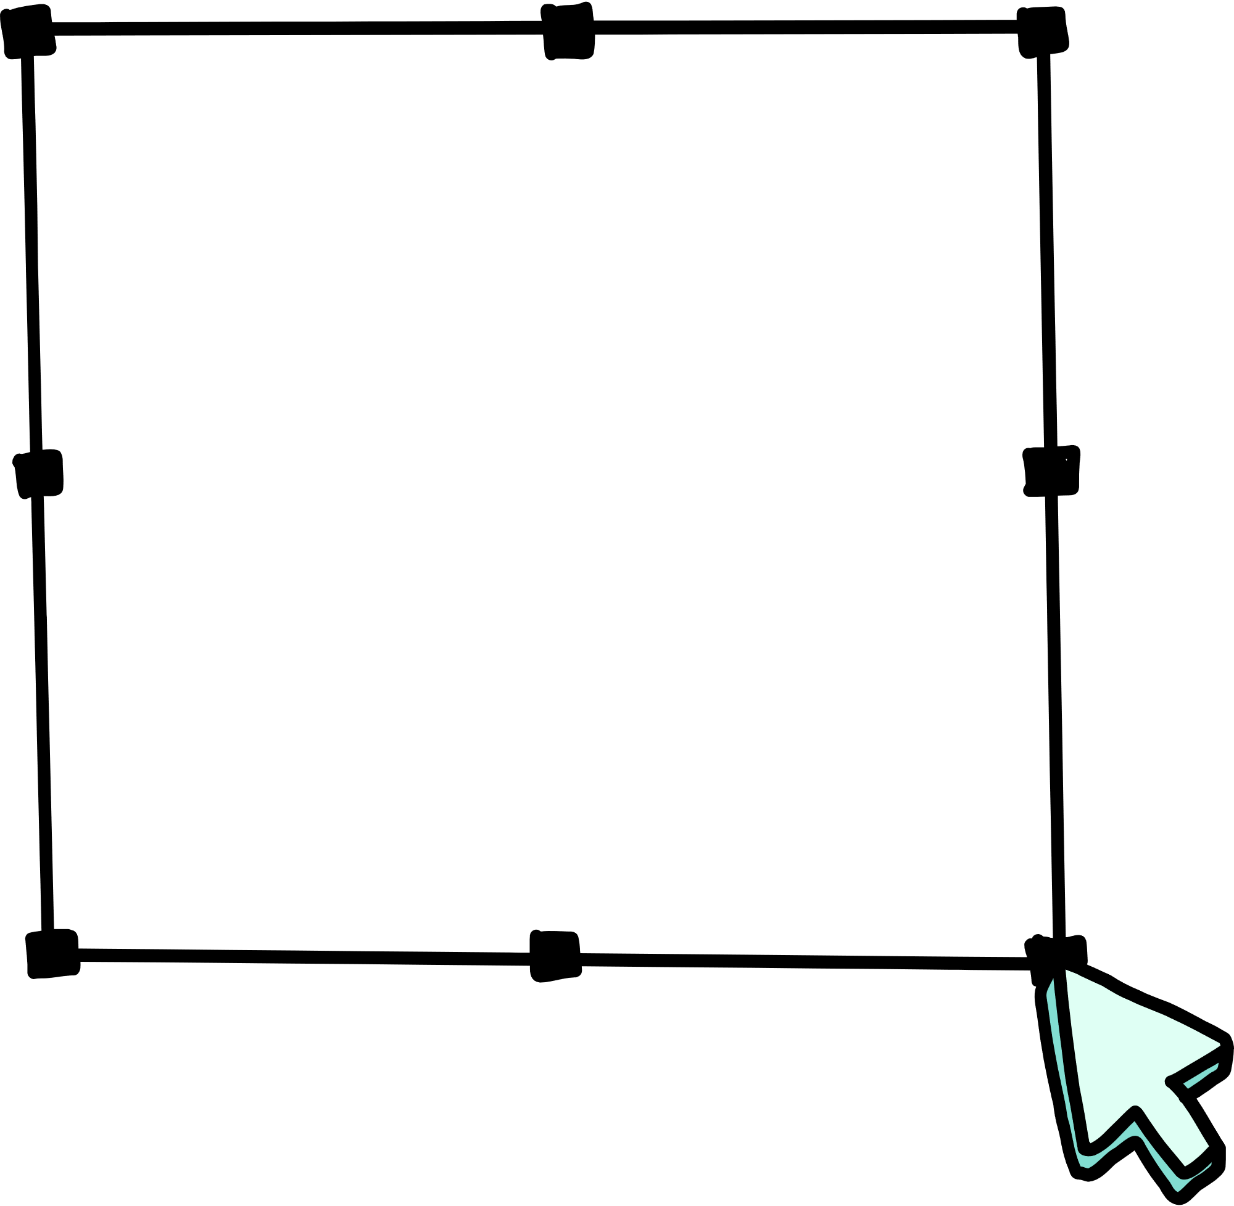


Introduction
Writing an essay is a crucial skill for advanced students, especially those preparing for placement and competitive exams.
A well-crafted essay demonstrates not only your understanding of a topic but also your ability to communicate ideas effectively..

Slide 3





Purpose of essay writing
Show your abilities to select relevant ideas and information.
Demonstrate knowledge and understanding of the topic.
Present a logical argument.
Organize ideas systematically.
Use sophisticated English.
Show your grasp of English Grammar and vocabulary.

Slide 4
Analyzing the question
Components of an Essay questions:
instruction Words: what to do
Key Words: indicates the main topic
Limiting Words: restrict the topic to a specific aspect

Slide 5
Crafting a Thesis Statement
A thesis statement is a single sentence that summarizes the main point or claim of your essay and is typically found in the introduction.

Slide 6


For advanced essays, a strong thesis statement should be:
CLEAR AND SPECIFIC
Avoid vague language and be as precise as possible
ARGUABLE
Present a claim that could be challenges or opposed
RELEVANT
Directly related to the topic and the instructions given in the essay prompt

Slide 7
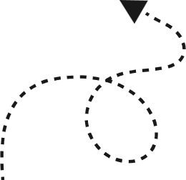
SOME EXAMPLES ARE:
"While the internet has revolutionized modern education by providing widespread access to information, it has also introduced significant challenges in terms of information overload and reduced critical thinking skills."
""Although social media has facilitated global communication, it has also led to a decline in face-to-face interactions and weakened interpersonal relationships."

Slide 8


Hook: A compelling opening sentence to grab the reader’s attention.
WRITING THE INTRODUCTION
The introduction serves as a roadmap for your essay. It should engage the reader, provide necessary background information, and present your thesis statement.
2. Background Information: Brief context about the topic.
3. Thesis Statement: Your main argument or position.

Slide 9


EXAMPLE
"In today’s digital age, the internet has become an integral part of education, offering students unprecedented access to information and learning resources. However, while this technological advancement has numerous benefits, it also poses significant challenges. This essay will explore both the positive and negative impacts of the internet on modern education, arguing that while it provides valuable tools for learning, it also risks overwhelming students and diminishing their critical thinking skills."

Slide 10
Topic Sentence: Introduces the main idea of the paragraph
Developing Body Paragraphs
2. Evidence: Provides facts, examples, or quotes to support the main idea.
Body paragraphs are where you develop your main ideas and support your thesis with evidence and analysis. Each paragraph should focus on a single point and follow a clear structure
3. Analysis: Explains how the evidence supports the main idea.
4. Transition: Connects the current paragraph to the next one.

Slide 11
EXAMPLE
"One of the most significant benefits of the internet in education is the accessibility of information. Students can easily find resources on any topic, which facilitates independent learning and research. For instance, online databases and academic journals provide access to a vast amount of scholarly material that would otherwise be unavailable to many students. This accessibility democratizes education, allowing learners from diverse backgrounds to access the same information and opportunities."

Slide 12
Common patterns in body paragraph
1
Point: Introduce the main point of the paragraph.
Evidence: Provide supporting evidence for the point.
Explanation: Explain how the evidence supports the point.
Link: Link back to the thesis statement and transition to the next paragraph.
2
3
4

Slide 13



. Writing the Conclusion
Summary of Main Points:
Restatement of Thesis:
Closing Thought:
The conclusion summarizes your main points and restates the thesis in a new way. It should also provide a final thought or call to action.
Briefly revisit the key arguments made in the essay.
A final observation or suggestion for further thought or action.
Reinforce the main argument without repeating it verbatim.

Slide 14
EXAMPLE
"In conclusion, while social media has transformed the landscape of communication, it has also led to a decline in the quality of interpersonal interactions among young adults. By prioritizing face-to-face conversations and being mindful of the time spent on social platforms, individuals can work towards rebuilding the depth and richness of their social connections."

Slide 15




INTRODUCING AN ARGUMENT
TRANSITIONING BETWEEN IDEAS
ADVANCED LANGUAGE AND USEFUL PHRASES
"Moreover..."
"In addition..."
"Conversely..."
"One significant aspect is..."
"Firstly, it is important to note..."
"Another key point is..."
PROVIDING EVIDENCE
"According to recent research..."
"For instance..."
"As demonstrated by..."
CONCLUDING AN ARGUMENT
ANALYZING EVIDENCE
"In summary..."
"Therefore..."
"Ultimately..."
"This indicates that..."
"This suggests..."
"This highlights the importance of..."

Slide 16
PRACTICE ESSAY PROMPT
Prompt: "Evaluate the impact of social media on interpersonal relationships."
1
Analyse the Question: Identify the instruction word, key word, and limiting words.
Craft a Thesis Statement: Present your main argument on the topic.
Write the Introduction: Include a hook, background information, and thesis statement.
Develop Body Paragraphs: Use topic sentences, evidence, analysis, and transitions.
Write the Conclusion: Summarize main points, restate the thesis, and provide a closing thought.
2
3
4
5

Slide 17
EXAMPLE
"While social media has revolutionized the way we communicate, it has also led to a decrease in face-to-face interactions and weakened interpersonal relationships. This essay will evaluate both the positive and negative impacts of social media on our personal connections, arguing that despite its benefits, social media ultimately diminishes the quality of our relationships by reducing meaningful interactions."

Slide 18
1. INCORPORATE CRITICAL THINKING
2. USE A VARIETY OF SENTENCE STRUCTURE
Question assumptions and explore different viewpoints.
Analyze the implications of your arguments.
Mix simple, compound, and complex sentences.
Vary sentence beginnings to avoid monotony.
ADVANCE
TECHNIQUES
3. ENHANCE VOCABULARY
Use precise and varied vocabulary.
Avoid repetition and use synonyms.
4. IMPROVE COHERENCE AND COHESION
5. EDIT AND PROOFREAD
Use linking words and phrases to connect ideas smoothly.
Ensure each paragraph flows logically into the next.
Check for grammar, spelling, and punctuation errors.
Ensure clarity and conciseness in your writing.

Slide 19
Carefully read and analyze
the question before starting your essay.
COMMON PITFALLS TO AVOID
Use advanced language appropriately, but ensure your writing remains clear and understandable.
Misinterpreting the Question
Stick to the main argument and avoid going off on tangents.
Overuse of Complex Language
Lack of Focus
Follow the essay structure to maintain coherence and clarity.
Summarize your arguments and provide a strong closing thought.
Neglecting the Conclusion
Ignoring Structure

Slide 20

WRITING TIPS
• Give your essays an interesting and appropriate introduction. It will help draw the attention of the reader and pique their curiosity
• Keep it between 300-500 words. This is the ideal length, you can take creative license to increase or decrease it.
• Keep your language simple and crisp. Unnecessary complicated and difficult words break the flow of the sentence.
• Do not make grammar mistakes, use correct punctuation and spelling five- paragraph. If this is not done it will distract the reader from the content.
• Before beginning the essay, organize your thoughts and plot a rough draft. This way you can ensure the story will flow and not be an unorganized mess.
.

Slide 21
WRITING TIPS
• Understand the Topic Thoroughly-Sometimes we jump to a conclusion just by reading the topic once and later we realize that the topic was different than what we wrote about. Read the topic as many times as it takes for you to align your opinion and understanding about the topic.
• Make Pointers-It is a daunting task to write an essay inflow as sometimes we tend to lose our way of explaining and get off-topic, missing important details. Thinking about all points you want to discuss and then writing them down somewhere helps in covering everything you hoped to convey in your essay.
• Develop a Plan and Do the Math-Essays have word limits and you have to plan your content in such a way that it is accurate, well-described, and meets the word limit given. Keep a track of your words while writing so that you always have an idea of how much to write more or less.
.

Slide 22


INTRODUCING AN ARGUMENT
PRESENTING AN EXAMPLE
One significant aspect is...
Firstly, it is important to note...
Another key point is...
To begin with...
For example...
For instance...
As an illustration...
Consider the case of...
PROVIDING EVIDENCE
ANALYZING EVIDENCE
According to recent research...
Studies have shown that...
Evidence suggests that...
A report by [author] indicates that...
This indicates that...This suggests that..
This highlights the importance of...
It can be inferred that..."

Slide 23
PROVIDING REASONS
INTRODUCING ALTERNATIVE VIEWPOINT
Because...
Due to...
Owing to...
Since
Alternatively...
On the other hand...
From another perspective…
Considering a different angle...
REINFORCEMENT
POINTS
INDICATING TIME
Moreover...
Furthermore...
In addition...
Additionally...
Initially...
Subsequently...
Eventually...
Previously...

Slide 24

KEY
Takeaways!
An essay usually follows the following format: introduction, main body, and conclusion.
Critical thinking refers to the process of analysing and evaluating information in a skillful way.
Before writing an essay, it is useful to create a plan, e.g., with a mind map or list.
To make your essay flow well, make sure to link back to the question and provide connections between paragraphs.
To ensure your ideas are clear, don't use vocabulary that is too complex.
After writing, proofread your work to check for mistakes.
Top tip! Use the P.O.W.E.R. process to write your practice essays:
P = Prepare - Do your research, narrow down your topic, brainstorm ideas.
O = Organise - Choose your best ideas, write a plan or outline of your essay, think about paragraphing.
W = Write it!
E = Edit your work. Check carefully for errors or unnecessary repetition.
R = Review and Reflect - When you practise for the exam, have someone else check your work too and think about what you can improve on next time.

Slide 25
THANK
YOU!
www.reallygreatsite.com

